Slide 1
Statistics Course Rabobank day 1
Faculteit sociale wetenschappen
Afdeling Methoden & Statistiek (M&S)

Slide 2
Five meetings
January 21 Basics of modern statistics; Inference
February 11 How to determine cut-off values
March 11 Classifications
March 25 Distributions
April 8 …

Slide 3
The team from the UU
Dr. Peter Lugtig prof. Dr. Peter van der Heijden dr. Gerko Vink
Prof. Dr. Daniel Oberski dr. Rebecca Kuiper prof. dr. Stef van Buuren

Slide 4
Today
Inference vs. prediction
Inference under a design
The role of (hypothesis) testing
Inference using a model
Under- and overfitting.
Linear and logistic regression,
Nonlinear model, splines

Slide 5
Today
Inference vs. prediction
Inference under a design
The role of (hypothesis) testing
break
Inference using a model
Under- and overfitting.
Linear and logistic regression,
Nonlinear model, splines
break
2 cases

Slide 6
Inference or prediction
“What is the inflation rate in the Netherlands”?
“What determines variations in house prices in NL”?
“Should Peter receive a higher credit limit?”
”What is the risk of Company X going bankrupt next year”?
“Which type of households are at risk of getting behind on their mortgage”?
“If mortgage interest rates increase to 5% next year, how many households will default on their mortgage?”

Slide 7
Inference or prediction
“What is the inflation rate in the Netherlands”?
“What determines variations in house prices”?
“Should Peter receive a higher credit limit?”
”What is the risk of Company X going bankrupt next year”?
“Which type of households are at risk of getting behind on their mortgage”?
“If mortgage interest rates increase to 5% next year, how many households will default on their mortgage?”

Slide 8
Inference or prediction
“What is the inflation rate in the Netherlands”?
“What determines variations in house prices”?
“Should Peter receive a higher credit limit?”
”What is the risk of Company X going bankrupt next year”?
“Which type of households are at risk of getting behind on their mortgage”?
“If mortgage interest rates increase to 5% next year, how many households will default on their mortgage?”

Slide 9
Inference central today
“What is the inflation rate in the Netherlands”?
“What determines variations in house prices”?
“Should Peter receive a higher credit limit?”
”What is the risk of Company X going bankrupt next year”?
“Which type of households are at risk of getting behind on their mortgage”?
“If mortgage interest rates increase to 5% next year, how many households will default on their mortgage?”

Slide 10
Inference: Using a small dataset to draw big conclusions
Consumer Price Inflation:
the price of a weighted average market basket of consumer goods and services purchased by households
Market basket: not all products, but a selection
Weighted average: some products more important than others.
So not a random selection, but a weighted selection

Slide 11
Sampling and inference
You hardly ever have all the data
Sample of people
Opinion polls to tell about voting behavior in NL
Sample of products
Product prices to inform CPI in NL
Sample of business
Investments, output in NL
For good inference you need to know: sample <-> population (NL)

Slide 12
Inference under a design
Ideally: You know exactly how sample was selected from population.
Simple random sample (a real lottery)
Stratified designs
Unequal selection probabilities, but still known

Slide 13
Design-based inference (1): Simple Random Sampling
“Real lottery”
Equal chance for everyone in population to be selected
In long run, the sample will exactly resemble the population
On all possible statistics!
Inference is easy
In 1 sample, some uncertainty
The larger the sample size, the lower uncertainty
Example: a simple random sample of account holders

Slide 14
Design-based inference (1): Simple Random Sampling and Margin of error

Slide 15
Intermezzo: The idea of testing in inference
% of unemployed in the Netherlands
Q4 – 2021: 2.8%
Q1 – 2022 : ???
Sample 1 (n=100): 2.5%
Standard error (s.e.): p(1-p)/√n -> (.025*.975)/ √100 = .002 (0.2%)
95% Confidence Interval: 2.5 +- 1.96*0.2. [2.1;2.9]
Confidence overlaps with Q4: no certain decline in employment
Sample 2 (n=1000): 2.5%
Standard error: p(1-p)/√n -> (.025*.975)/ √1000 = .0008 (.08%)
95% Confidence Interval: 2.5 +- 1.96*0.08 [2.34;2.66] -> decline!
(EBB in 2020. n=45000: s.e. = .0001)

Slide 16
Design-based inference (2): Stratified designs
Example: CPI
Not all products should get an equal weight!
Products that people spend lots on, should compose a higher proportion of the basket
Rent, Groceries, energy, insurance
Sample with unequal weights - stratification
Example: sample stratified on activity of account

Slide 17
Design-based inference (3):
A BIG problem:
Very often, no control over sampling design
You just have to deal with the data you get
Unclear how it matches the population
Difference between sample and population?
Possible bias

Slide 18
Model-based inference (3):
Statistical model to describe reality
“What is the inflation rate in the Netherlands”?
Sometimes inference more about variation
“What determines variations in house prices”?
Many, many different statistical models
Today: Regression

Slide 19
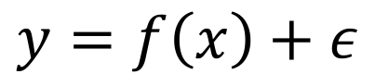
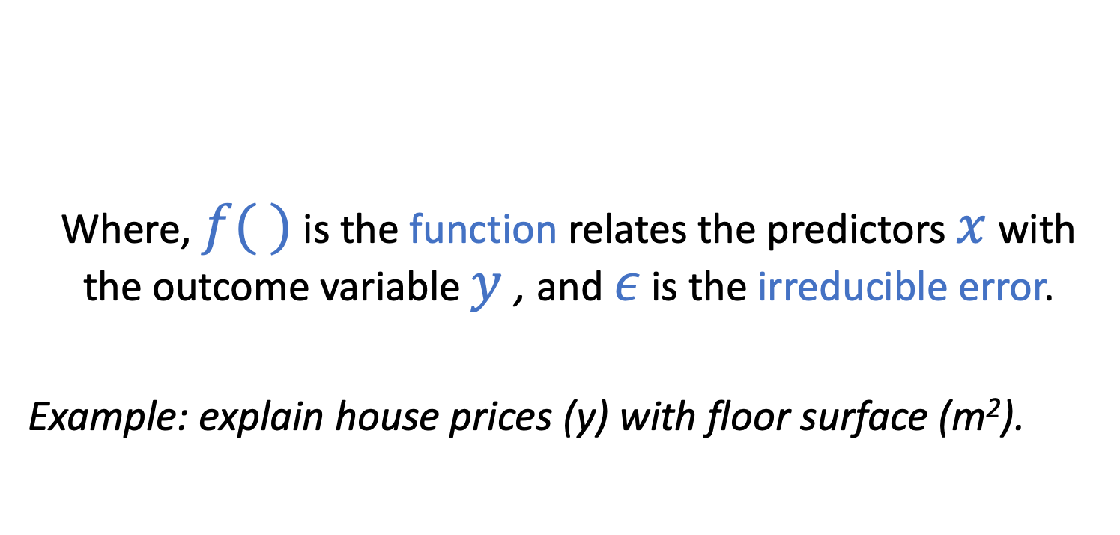
Regression: overview
Where, $f( )$ is the function relates the predictors $x$ with the outcome variable $y$ , and $ε$ is the irreducible error.
Example: explain house prices (y) with floor surface (m²).
$$y=f\left(x\right)+ε$$

Slide 20
Different goals of regression
Prediction: the goal is to obtain accurate predictions of y.
Given x and y, work out f(x); use f(x) to predict values of y
“engineering mindset”: A → B, focus on reaching B
Inference: the goal is to understand the process that relates x and y.
“Is x related to y?”
“How is x related to y?”
“How precise are parameters of f(x) estimated from the data?”
“scientific mindset”: A → B, focus on ”→”

Slide 21
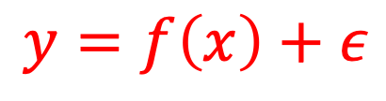
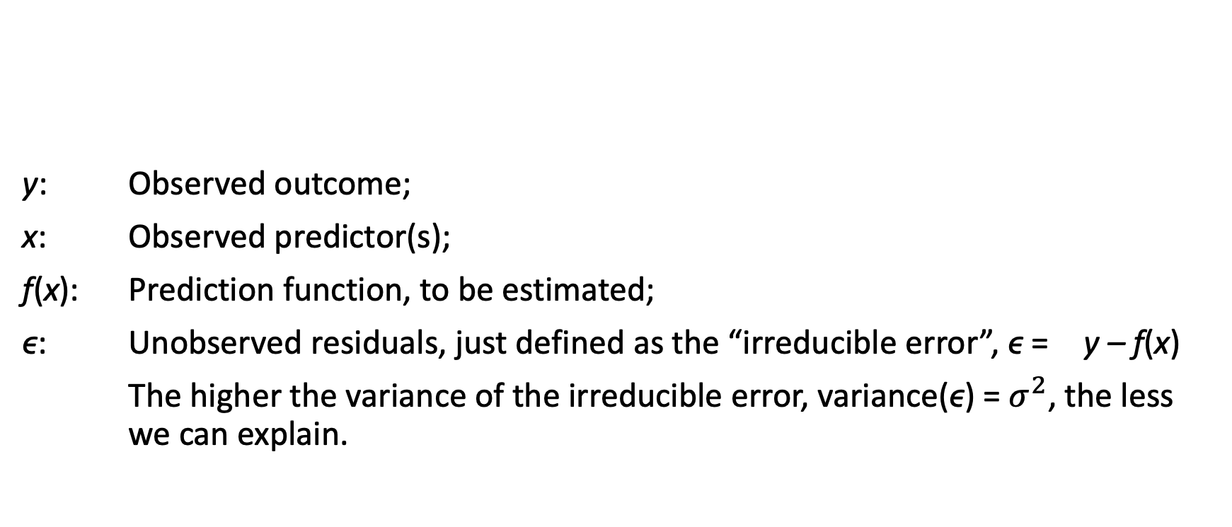
Regression: overview
y: Observed outcome;
x: Observed predictor(s);
f(x): Prediction function, to be estimated;
ϵ: Unobserved residuals, just defined as the “irreducible error”, ϵ = y – f(x)
The higher the variance of the irreducible error, variance(ϵ) = $σ^{2}$, the less we can explain.
$$y=f\left(x\right)+ε$$

Slide 22
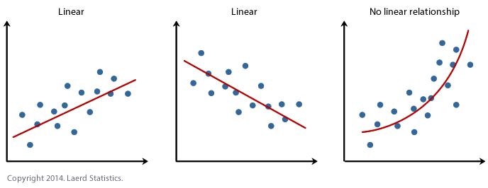
Regression: overview
f(x) can take different identities:
Linear regression vs non-linear regression
One or more predictors (x)
Floor surface, region, garden, etc….

Slide 23
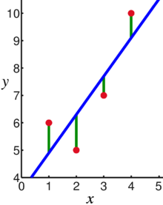
Linear regression
In linear regression, the mean of the outcome y is assumed to be a linear combination of the regression coefficients (b’s).
y = b₀ + b₁ x
In linear regression, the observations (red) are assumed to be the result of random deviations (green) from an underlying relationship (blue) between a outcome variable (y) and an predictor (x).

Slide 24
Testing in regression
y = b₀ + b₁ x
The blue line (b₁) is also estimated and includes uncertainty (sampling)
We get a standard error with every coefficient
And then test whether b₁
by constructing the confidence interval around B₁ (+- 1.96 * s.e.)
and testing whether that confidence includes 0 (B₁ > 0)

Slide 25
Break (15 min)

Slide 26
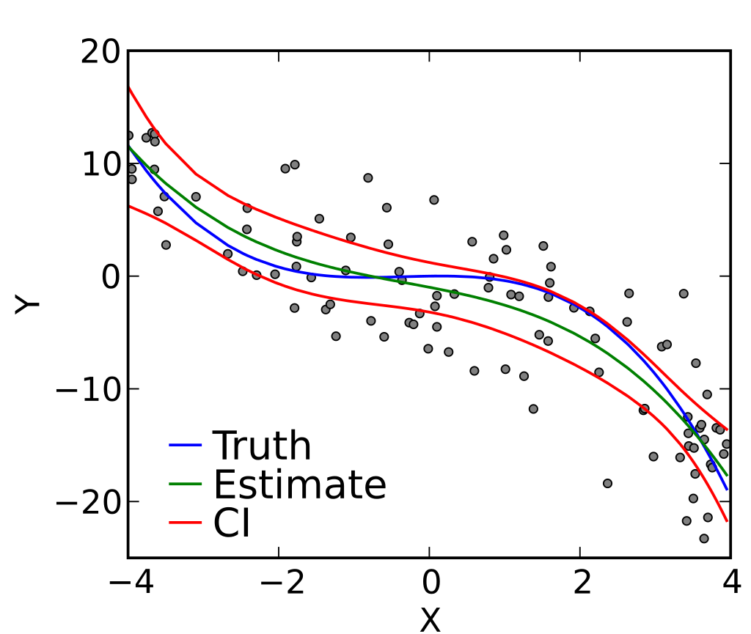
Linear regression
f(x) can take different identities in linear regression:
1 or more independent variables (predictors):
f(x) = b₀ + b₁ x
f(x) = b₀ + b₁ x₁ + b₂ x₂ + … + b_{n} x_{n}
Can be polynomials of different degrees:
1st degree: f(x) = b₀ + b₁ x
2nd degree: f(x) = b₀ + b₁ x + b₂ x²
n^{th} degree: f(x) = b₀ + b₁ x + b₂ x² + … + b_{n} x^{n}
ie. Polynomial regression of 3rd degree

Slide 27
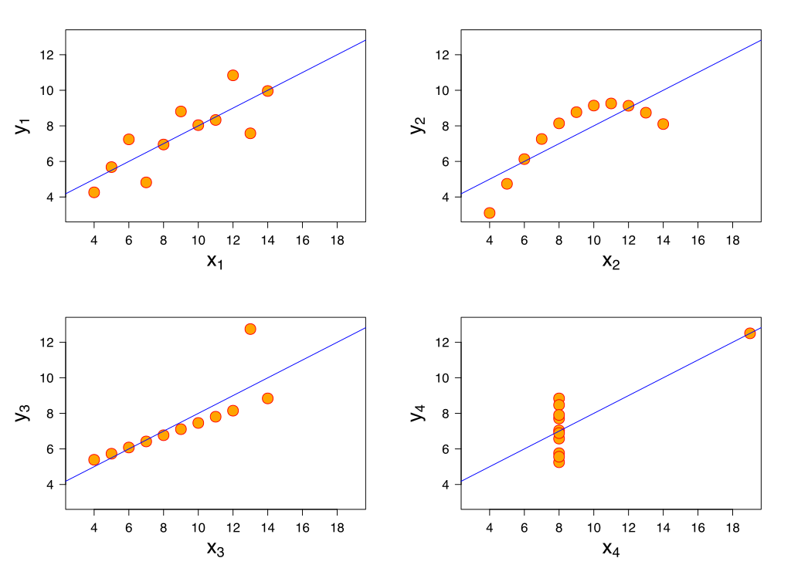
Issues with fitting a regression
The four models produce the same fitted curves. Can you identify the following?
Quadratic relation.
Not related.
Linear relation with observed noise.
Linear relation with an outlier (an extreme observation).
Why is it so important to visually inspect the regression fitted?

Slide 28
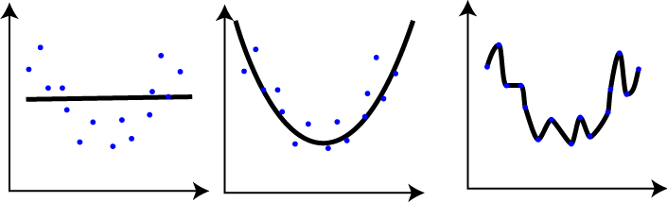
Underfitting and Overfitting
Underfitted
Good fit
Overfitted

Slide 29
Short exercise - Linear regression
I am going to show you a small data set, and we are going to try to estimate f(x) and predict y;
I generated this data set myself using R, so I know the true f(x) and distribution of ϵ.
For now, however assume that we have a sample

Slide 30
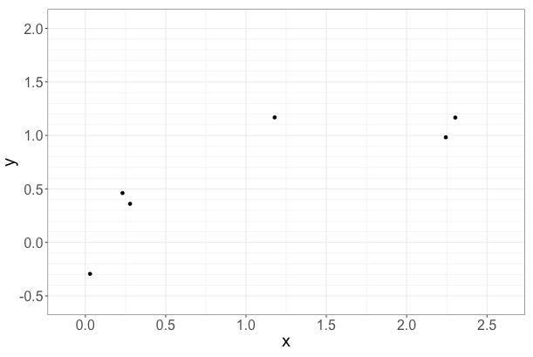
Task: predict (however you want): y for x = 0.5, 1.5, 2.0

Slide 31
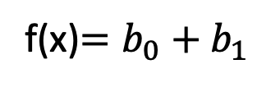
Discussion of results
Linear regression:
(so, )
Linear regression with quadratic term:
Linear regression with quadratic and cubic terms:
$$y_{i}=b_{0}+b_{1}x_{i}+ ε_{i}$$
f(x)$=b_{0}+b_{1}$
$$y_{i}=b_{0}+b_{1}x_{i}+b_{2}x_{i}^{2}+ ε_{i}$$
$$y_{i}=b_{0}+b_{1}x_{i}+b_{2}x_{i}^{2}+b_{3}x_{i}^{3}+ ε_{i}$$

Slide 32
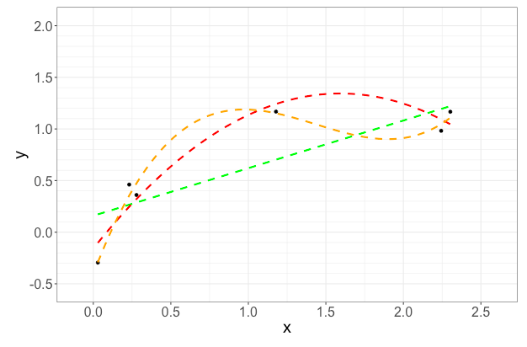

Slide 33
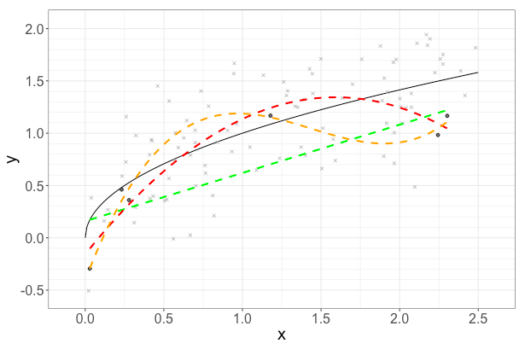
The truth (normally we don’t know this)

Slide 34
Discussion of results: comparing results
Model | f(0.5) | f(1.5) | f(2.0)
Eyeballing
LR (Polynomial degree = 1) | 0.40 | 0.85 | 1.10
Polynomial (degree = 2)
Polynomial (degree = 3)
Actual function | 0.71 | 1.22 | 1.58

Slide 35

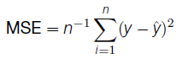
Evaluating model accuracy
The predictions y differ from the true y;
We can evaluate how much this happens “on average”.
A systematic way of evaluating how good is the fit of a model is using the Mean Squared Error (MSE):
Mean squared error (MSE):

Slide 36
Discussion of results: comparing MSE results
True f(x): y = √x + ϵ
with ϵ ~ Normal(0; 1)
Model | MSE
Eyeballing
LR (Pol. degree = 1) | 0.1545
Pol. degree = 2
Pol. degree = 3

Slide 37
Discussion of results: what happened?
There were few observations, relative to the complexity of the polynomial of third degree;
The polynomial of first degree did not offer a good representation of the nonlinear function, it underfitted the data
The polynomial of second degree performed better in this example;
BUT
By chance, some patterns appeared that are not in the true f(x);
The most flexible model f(x) overfitted these patterns
Perhaps with a larger sample the most flexible model would have performed better than the other two!

Slide 38
Overfitting and what to do…
Overfitting here happens because of f(x) is too flexible
Can also happen because of too many predictors (x₁, x₂, x₃,… x_{n})
Good practice:
Use predictors and complex polynomials sparingly
Hold out samples and cross-validation
Split data up in two parts
Use part 1 to build the model
And part 2 to test it

Slide 39
Extensions of regression models (1)
Logistic regression:
Binary outcomes
F(x) now not linear, but logistic
Marginal effects to interpret results as probabilities
If X increases 1 unit, how how the predicted probability on Y-axis change
Popular in machine learning

Slide 40
Extensions of regression models (2)
Splines
Not one regression model across whole range of X
E.g. When X is income, age,….
l
Linear regression model Regression splines (2)

Slide 41
Piecewise regression
Example: policy changes over time on X-axis (knots)
Regression discontinuity designs

Slide 42
Conclusion
Regression can be used for inference:
Using a sample to understand predictors of Y
Which predictors are important
Which are not
Can also be used to predict actual values in Y
What is predicted house value (y) given values of X
If someone would extend house floor space 20 m², what would predicted Y be?
Underfitting is a problem, but overfitting too
In prediction models overfitting less of a problem (?)
Regression is very flexible
It is used a lot in practice

Slide 43
Exercises
1. Introduction to JASP
2. Regression in JASP
3. Intro to R
4. Regression in R

Slide 44
Break (15 min)

Slide 45
Two cases

Slide 46
Thank you
Questions?
E-mail: p.lugtig@uu.nl
G.vink@uu.nl
P.g.m.vanderheijden@uu.nl

